Slide 1
Credit Card Fraudulent Transaction Detection
University Of Kalyani
Department Of Computer Science & Engineering
Seminar on
MCA 321: Project-I
Presented By:
Mouli Dutta (Roll: 90/MCA No.: 220018)
Abhijit Mahato (Roll: 90/MCA No.:220001)
Biman Mahato (Roll: 90/MCA No.: 220009)
Guided By:
Professor (Dr.) Kalyani Mali

Slide 2
Index
Introduction
Analyzing the Data
Experiment methods
Performance Evaluation and Results
Conclusion
References

Slide 3
Introduction
Fraud is deceit or dishonesty with the intent to gain an unfair or unlawful advantage, often involving deception for financial or personal gain.
Credit Card Fraud
Credit card fraud includes identity theft, where someone uses another person’s information, and card skimming, involving unauthorized copying of card details, both leading to fraudulent transactions.
How Frauds are Recognized
Anomaly Detection: Identify unusual patterns or transactions that deviate from one’s typical spending behaviour.
Geographical Analysis: Flagging transactions from unfamiliar locations or regions can signal potential fraud.
Transaction Monitoring: Continuous real-time monitoring helps detect and respond to suspicious activities promptly.

Slide 4
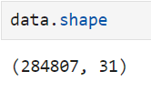
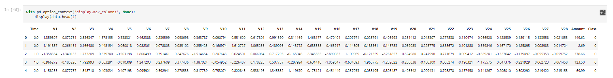
Analyzing the Data
The dataset is acquired from Kaggle
The dataset contains 31 features and 2,84,807 rows.
Out of which V1 to V28 have been transformed with Principal Component Analysis (PCA) for privacy of users.
The other three features are time, amount and class either 1 for fraud and 0 otherwise.

Slide 5
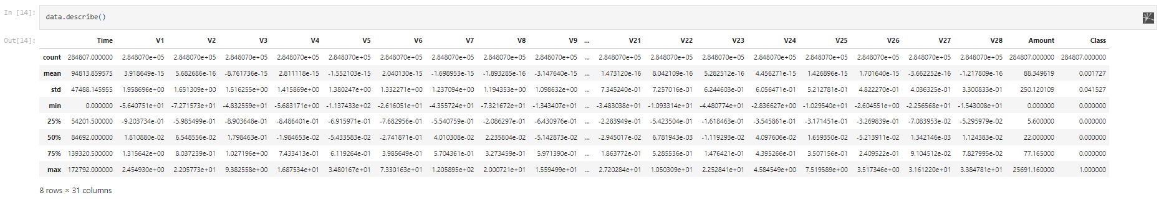
Analyzing the Data (Contd…)

Slide 6
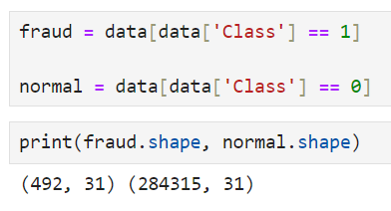
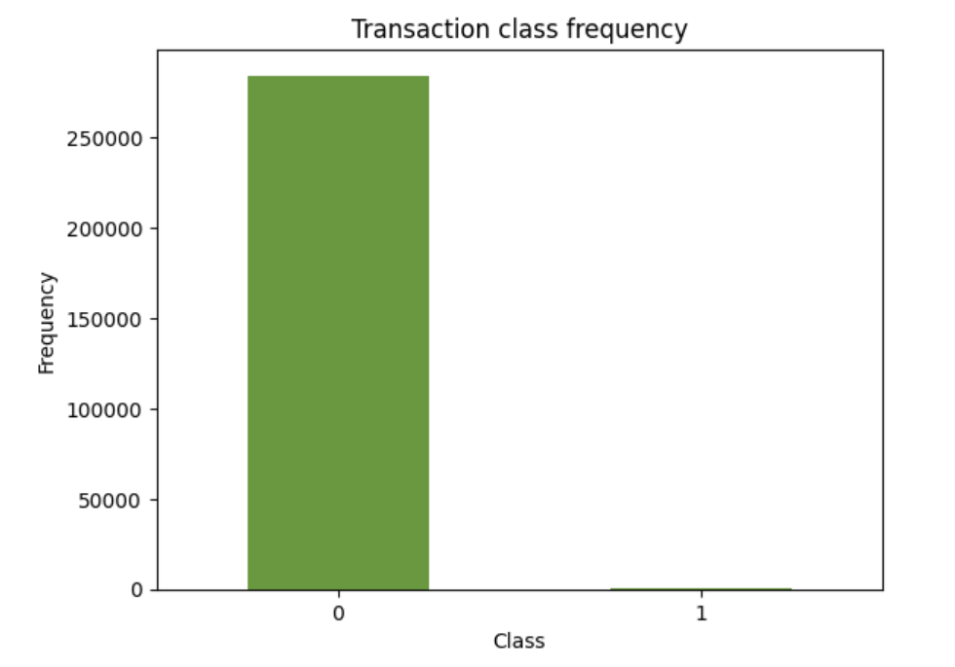
Analyzing the Data (Contd…)
The data is highly skewed as it consists of 2,84,315 authentic transactions and 492 fraudulent transactions which is approximately 0.172% of total transactions.

Slide 7
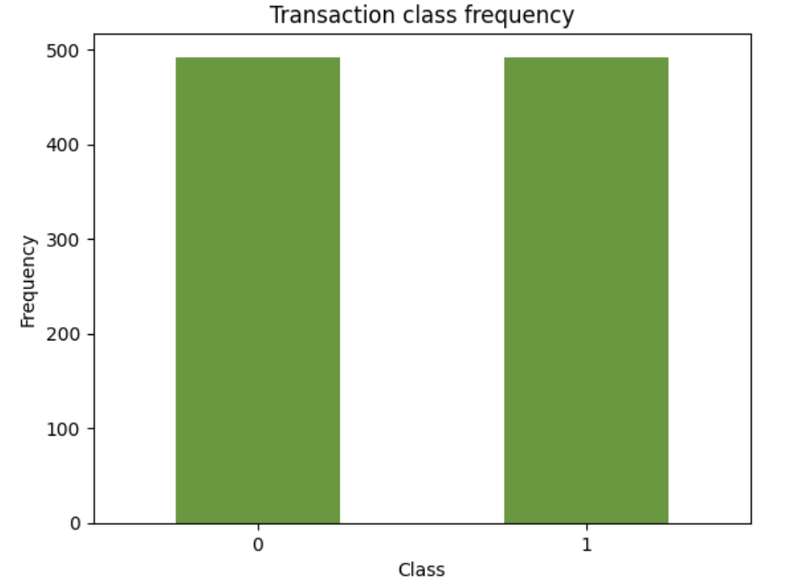
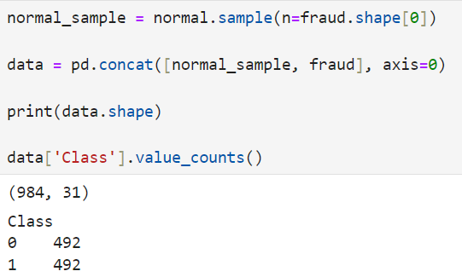
Experiment Methods
Resampling: To adjust the class distribution of the data as the minority class is not equally represented we performed Undersampling.

Slide 8
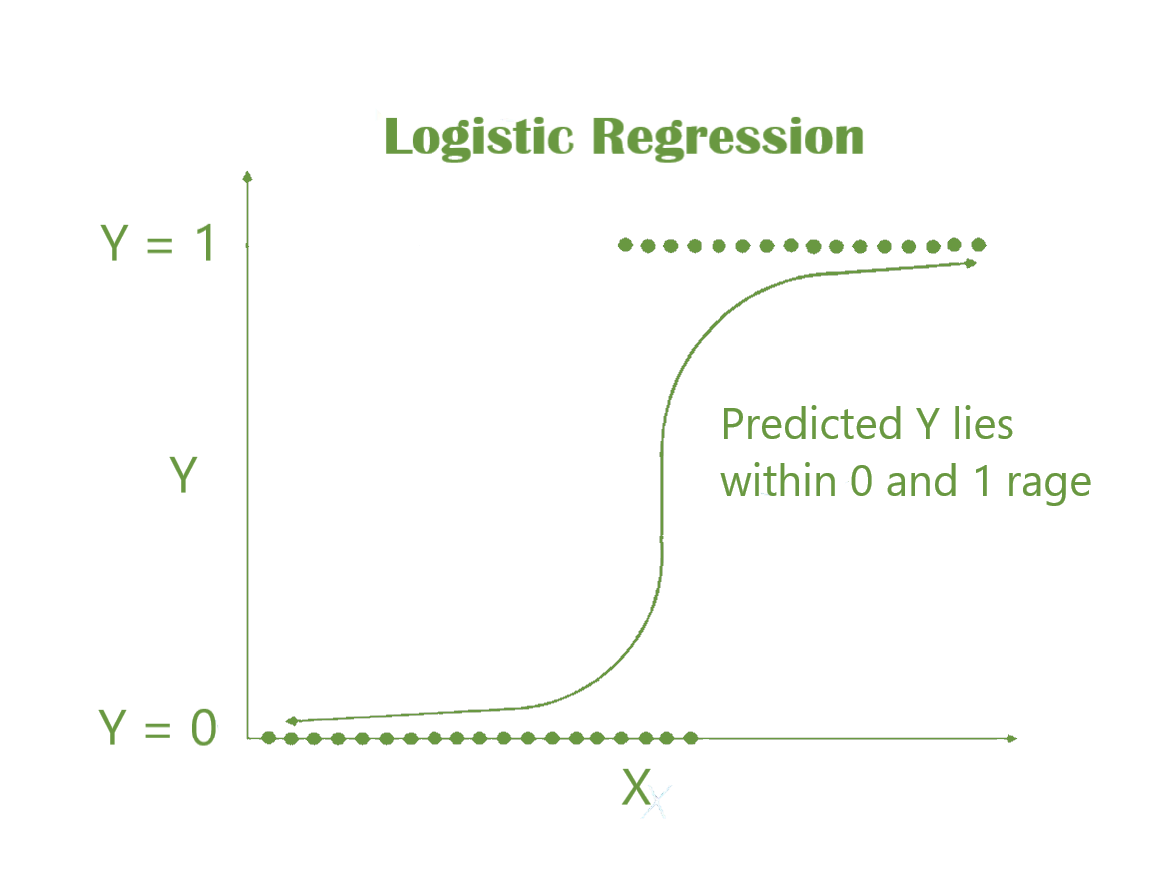
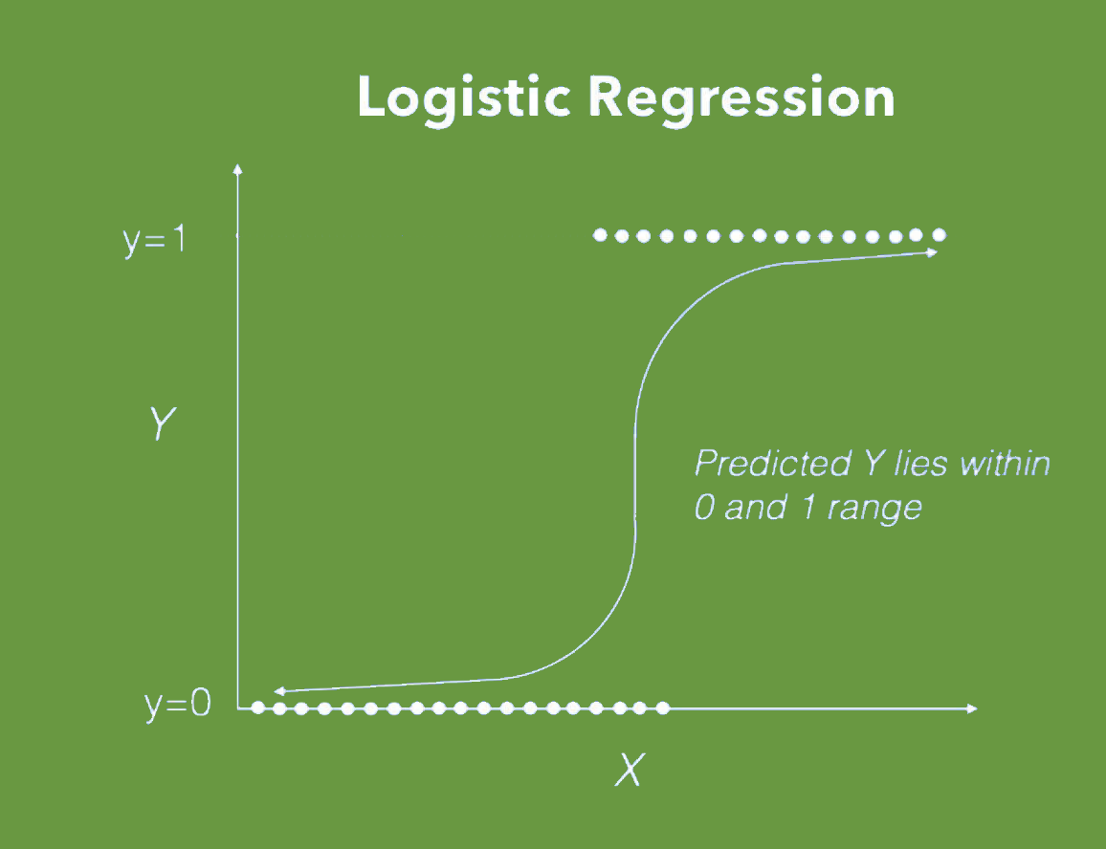
Logistic Regression Classifier
Binary Classification: Logistic Regression is a statistical method used for binary classification problems, where the outcome variables has two categories or classes.
https://miro.medium.com/max/1280/1*iKo3KI4kqkZ47W7pmmH4cw.png

Slide 9
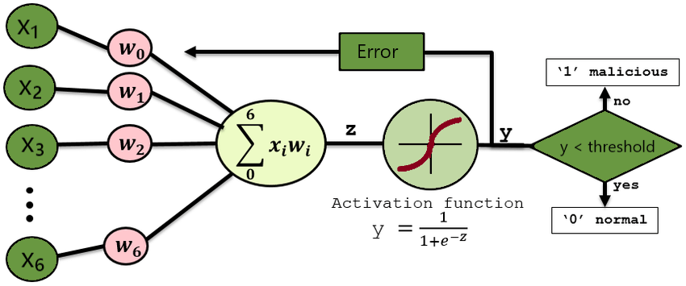
Working of Logistic Regression Model
Visualization of a Logistic Regression classifier. | Download Scientific Diagram (researchgate.net)

Slide 10
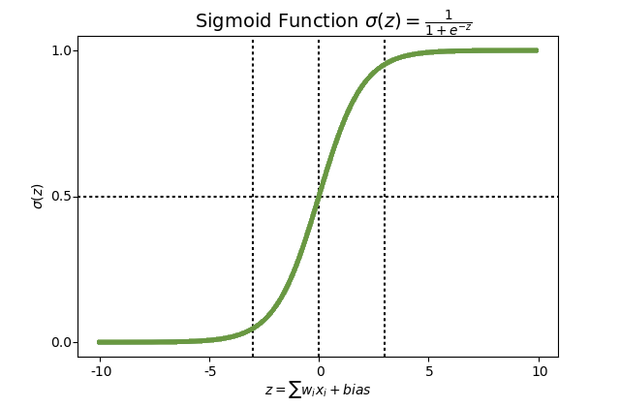
Contd…
Sigmoid Function: It employs the sigmoid (logistic) function to transform the output into a probability score between 0 and 1, mapping predictions to the probability of belonging to a particular class.
https://th.bing.com/th/id/OIP.rfgUCt8EgAf66LPRGLJukgHaGE?rs=1&pid=ImgDetMain

Slide 11
Contd…
Decision Boundary: Logistic regression determines a decision boundary separating the classes based on input features, aiding in classifying new data points.
Decision Boundary
https://th.bing.com/th/id/OIP.rfgUCt8EgAf66LPRGLJukgHaGE?rs=1&pid=ImgDetMain

Slide 12
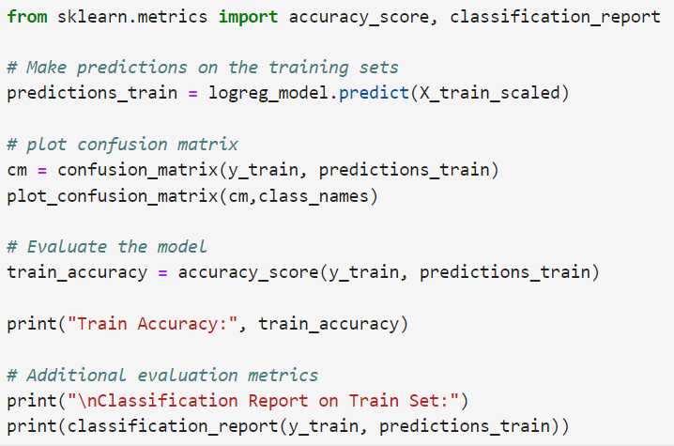
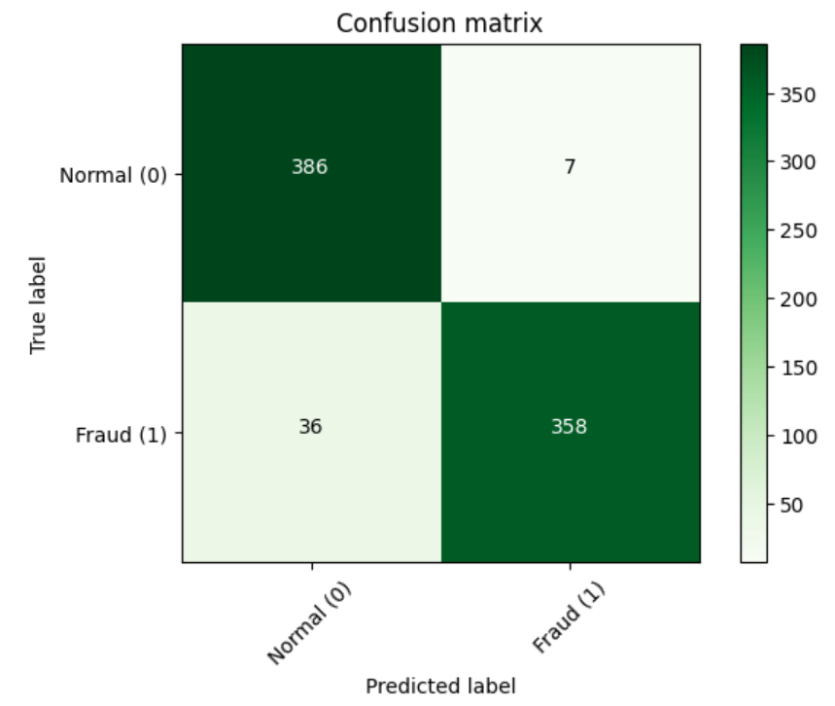
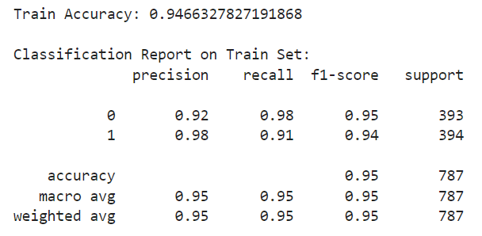
Output

Slide 13
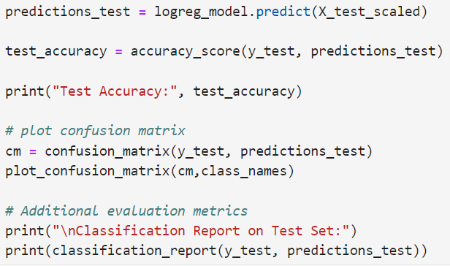
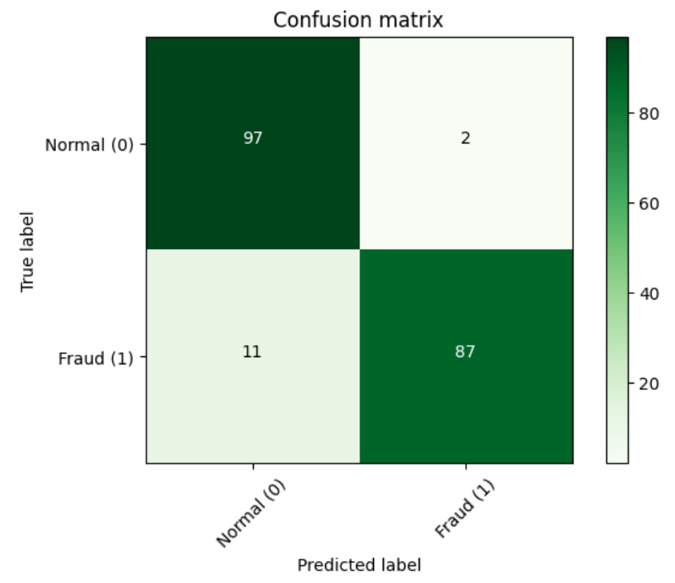
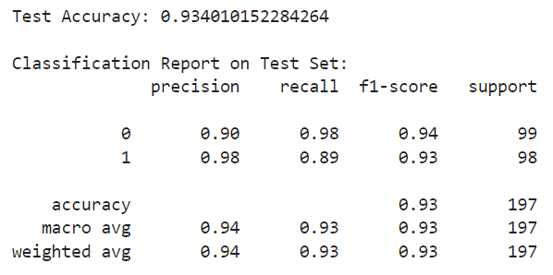
Contd…

Slide 14
K-Nearest Neighbor
K-Nearest neighbor is one of the simplest Machine Learning algorithms based on Supervised Learning technique.
K-NN algorithm assumes the similarity between the new case/data and available cases and put the new case into the category that is most similar to the available categories.
K-NN algorithm stores all the available data and classifies a new data point based on the similarity.
This means when new data appears then it can be easily classified into a well suite category by using K- NN algorithm.

Slide 15
Features Of K-NN
K-NN algorithm can be used for Regression as well as for Classification but mostly it is used for the Classification problems.
K-NN is a non-parametric algorithm, which means it does not make any assumption on underlying data.
It is also called a lazy learner algorithm because it does not learn from the training set immediately instead it stores the dataset and at the time of classification, it performs an action on the dataset.
KNN algorithm at the training phase just stores the dataset and when it gets new data, then it classifies that data into a category that is much similar to the new data.

Slide 16
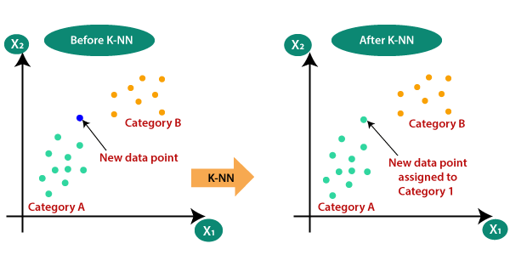
Need Of K-NN
Suppose there are two categories, i.e., Category A and Category B, and we have a new data point x1, so this data point will lie in which of these categories.
To solve this type of problem, we need a K-NN algorithm.
With the help of K-NN, we can easily identify the category or class of a particular dataset.
Consider the below diagram:
https://www.javatpoint.com/k-nearest-neighbor-algorithm-for-machine-learning

Slide 17
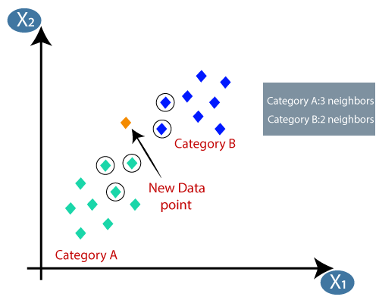
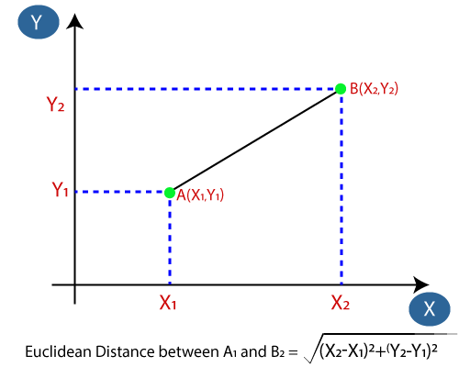
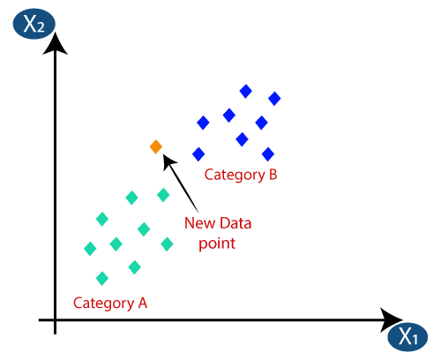
Working Of K-NN
Step-1: Select the number K of the neighbors
Step-2: Calculate the Euclidean distance of K number of neighbors
Step-3: Take the K nearest neighbors as per the calculated Euclidean distance.
Step-4: Among these k neighbors, count the number of the data points in each category.
Step-5: Assign the new data points to that category for which the number of the neighbor is maximum.
Step-6: Our model is ready.
https://www.javatpoint.com/k-nearest-neighbor-algorithm-for-machine-learning

Slide 18
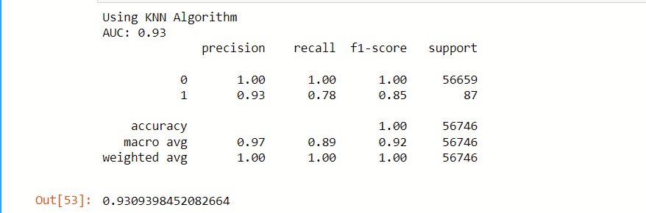
Result
Output for K-Nearest Neighbor:

Slide 19
Navïe Bayes
Naïve Bayes algorithm is a supervised learning algorithm, which is based on Bayes theorem and used for solving classification problems.
It is mainly used in text classification that includes a high-dimensional training dataset.
Naïve Bayes Classifier is one of the simple and most effective Classification algorithms which helps in building the fast machine learning models that can make quick predictions.

Slide 20
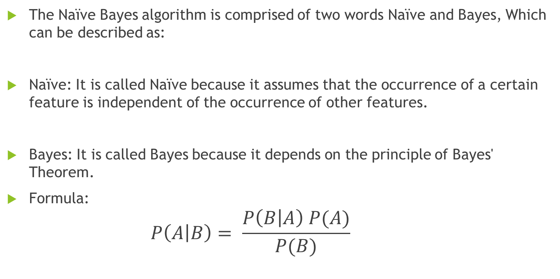
Why is it called Naïve Bayes?
The Naïve Bayes algorithm is comprised of two words Naïve and Bayes, Which can be described as:
Naïve: It is called Naïve because it assumes that the occurrence of a certain feature is independent of the occurrence of other features.
Bayes: It is called Bayes because it depends on the principle of Bayes' Theorem.
Formula:
$$P\left(A | B\right)= \frac{P\left(B | A\right) P(A)}{P(B)}$$

Slide 21
Implementation steps of Naïve Bayes algorithm:
step1: Data Pre-processing step
step2: Fitting Naive Bayes to the Training set
step3: Predicting the test result
step4: Creation of Confusion matrix
step5: Our model is ready.

Slide 22
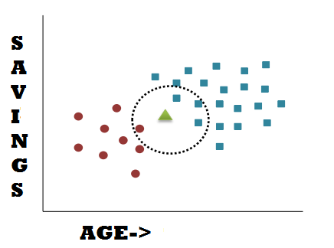
Need of Naïve Bayes algorithm:
Here are some reasons why we might want to use the Naive Bayes algorithm:
Simplicity
Efficiency
Performance
Scalability

Slide 23
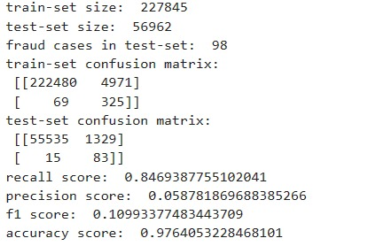
Result
Output for Naïve Bayes algorithm:

Slide 24

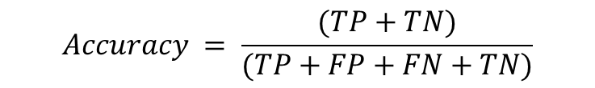
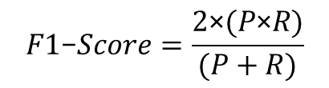

Performance Evaluation and Results
Confusion Matrix:
A confusion matrix provides a clear breakdown of the model's performance.
It helps identify true positives, true negatives, false positives, and false negatives, giving insight into how well the model distinguishes between real and fraud transactions.
$$Accuracy = \frac{(TP+TN)}{(TP+FP+FN+TN)}$$
Actual Values
Positive(1) Negative(0)
TP | FP
FN | TN
$$Precision = \frac{TP}{(TP+FP)}$$
Positive(1)
Predicted Values
$$Recall = \frac{TP}{(TP+FN)}$$
Negative(0)
$$F1\text{−}Score=\frac{2\text{×}(P\text{×}R)}{(P+R)}$$

Slide 25
Contd…
Algorithm | Accuracy
Logistic Regression | 94%
K-Nearest Neighbor | 93%
Naïve Bayes | 97%
We have implemented three algorithms on the given dataset for credit card fraud detection and it shows that Naïve Bayes outperforms other models.
The accuracy of Naïve Bayes is higher compared to other two classification algorithms.

Slide 26
Conclusion
In short, our Credit Card Fraud Detection project is a strong tool against false information, using smart computer techniques.
Though it works well, we need to keep being careful, work together, and think about what's right when dealing with fraud detection.
This project is a small step in making the internet a better and more truthful place.

Slide 27
References
Awoyemi, John O., Adebayo O. Adetunmbi, and Samuel A. Oluwadare. "Credit card fraud detection using machine learning techniques: A comparative analysis." In 2017 international conference on computing networking and informatics (ICCNI), pp. 1-9. IEEE, 2017.
Alammar, Ahmad, Yazeed Al Moayed, and Nasir Ahmed Algeelani. "DEBIT AND CREDIT CARD FRAUD DETECTION USING KNN IN MACHINE LEARNING."
Dornadula, Vaishnavi Nath, and Sa Geetha. "Credit card fraud detection using machine learning algorithms." Procedia computer science 165 (2019): 631-641.
Tiwari, Pooja, Simran Mehta, Nishtha Sakhuja, Jitendra Kumar, and Ashutosh Kumar Singh. "Credit card fraud detection using machine learning: a study." arXiv preprint arXiv:2108.10005 (2021).
Chaudhary, Khyati, Jyoti Yadav, and Bhawna Mallick. "A review of fraud detection techniques: Credit card." International Journal of Computer Applications 45, no. 1 (2012): 39-44.
AlEmad M. Credit Card Fraud Detection Using Machine Learning.
Patil, Tejaswini, and Kiran Khadare. "Credit Card Fraud Detection." (2023).
Fraud Detection in Transaction Data using KNN | Kaggle
https://www.kaggle.com/code/sashikantaparida/credit-card-fraud-knn-random-forest-logistic-reg
https://www.javatpoint.com/k-nearest-neighbor-algorithm-for-machine-learning
Logistic Regression: Sigmoid Function and Threshold | by Mukesh Chaudhary | Medium

Slide 28
THANK YOU

